Slide 1
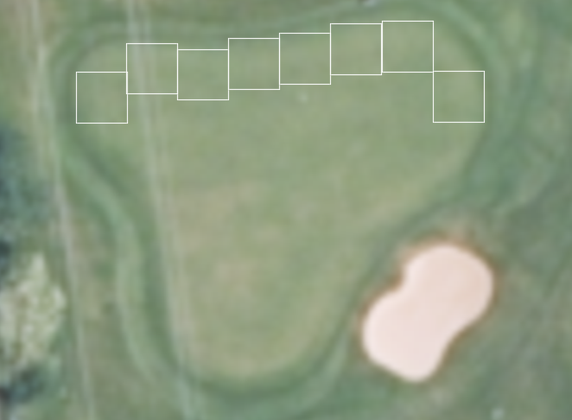
First row of boxes is placed 3m from the edge

Slide 2
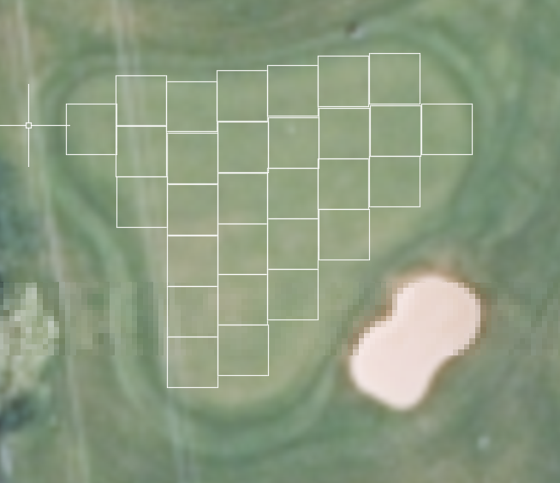
Then additional boxes are placed at a distance of 3 m – in this example 27

Slide 3
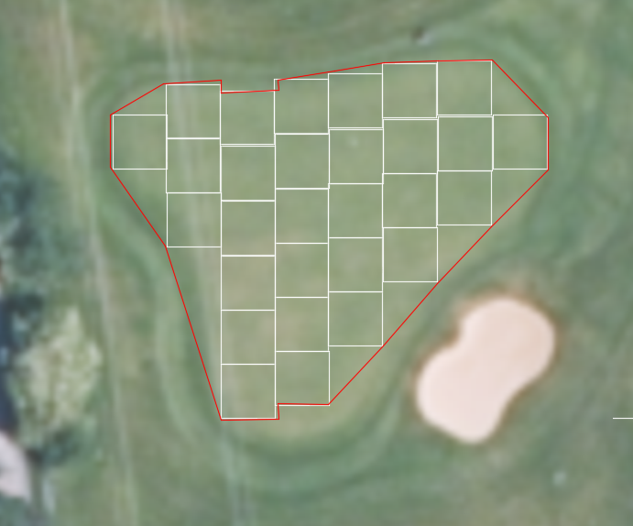
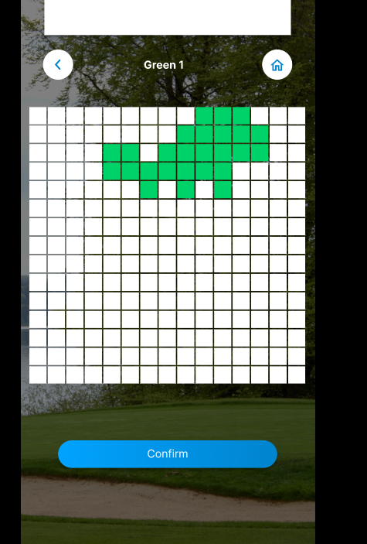
In the app, the user now specifies the area of the boxes as green boxes. This step is already correctly included in the app (see image below).
A line is now drawn around the corners of the boxes to recreate the contour of the green.

Slide 4
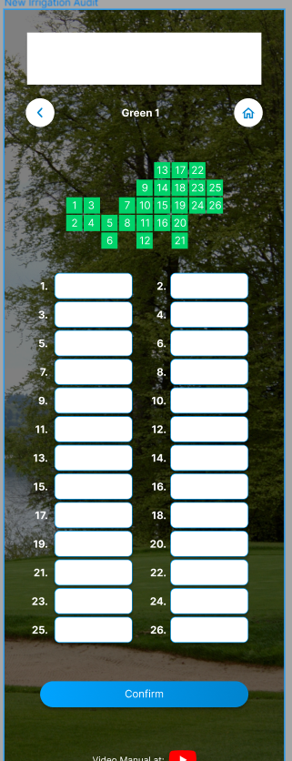
This step is already included in the app
Each box gets a number and a value can be entered
1 = 5ml
2 = 7ml
3 = 7ml
3
2
1

Slide 5
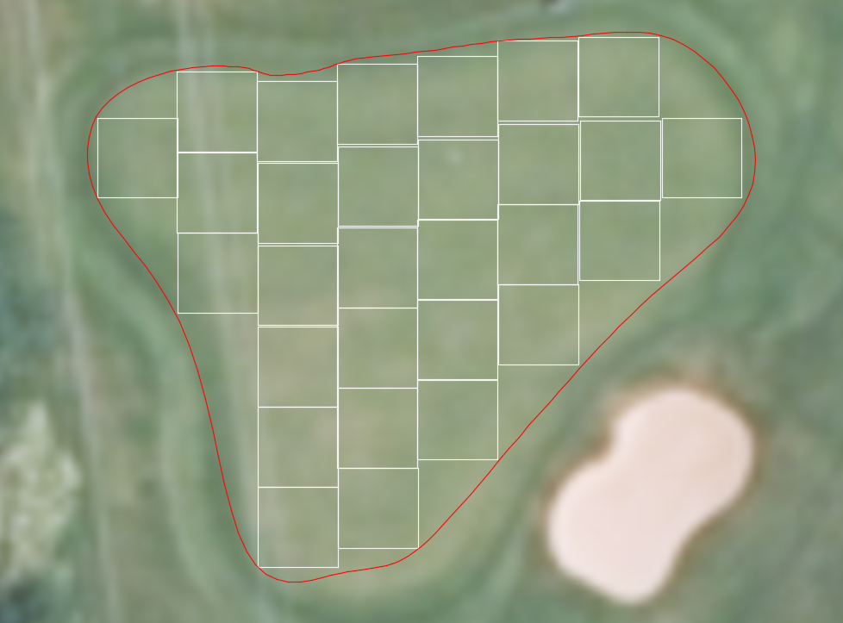
The square line is transformed into a “ spline ” (smoothed line without edges) and finally the contour of the green is exported

Slide 6
…assuming the following values were entered…
The values should be interpolated and displayed as a heatmap
12
12
12
12
33
10
10
14
14
14
14
34
2
10
14
14
14
14
10
1
19
19
19
19
21
21
21
21
6
8th

Slide 7


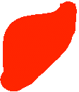
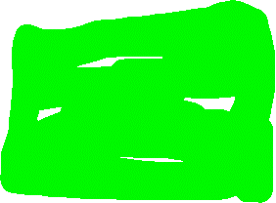



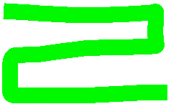



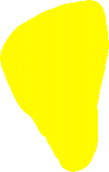








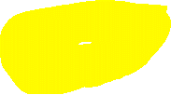





The finished heatmap then only shows the colors and the contour of the green
The colors are inserted based on the values
12
12
12
12
33
10
10
14
14
14
14
34
2
10
14
14
14
14
10
1
19
19
19
19
21
21
21
21
6
8th
The colors should range from red (for low readings) to yellow, green and dark green.

Slide 8
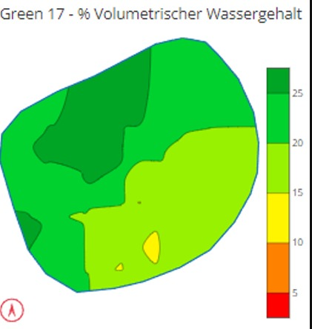
APPENDIX - Example of an interpolated heatmap

Slide 9
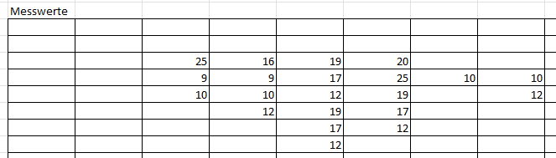

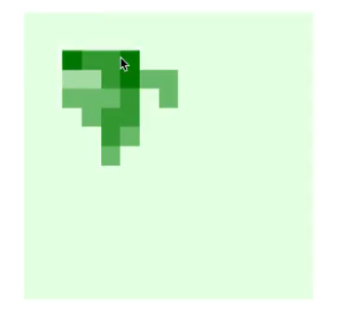
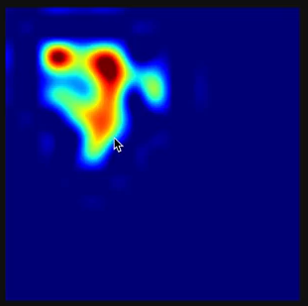
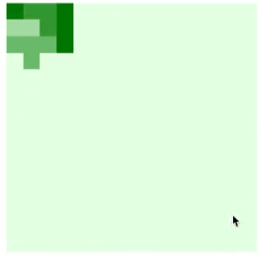
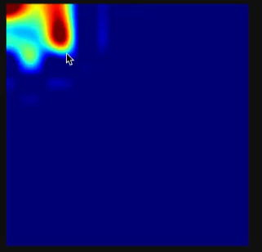
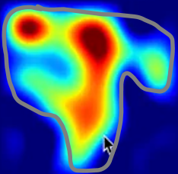
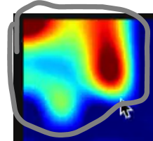
















Comparison:
The color scheme should range from red (for low measured values) to yellow, green and dark green! Currently this is reversed
The heatmap should only be displayed for the relevant area (with measured values). See my drawings below.
Cells that should not be filled should not be colored
HIGH
LOW
HIGH
LOW

